Slide 1



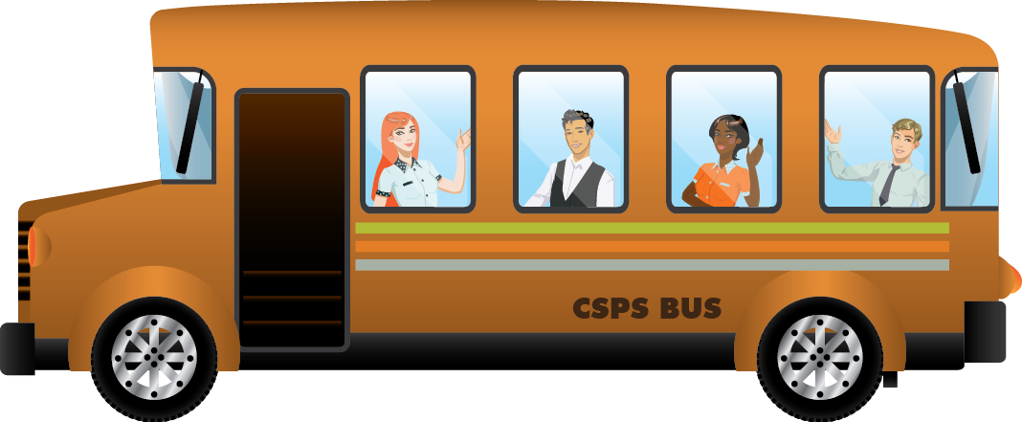

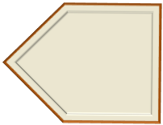



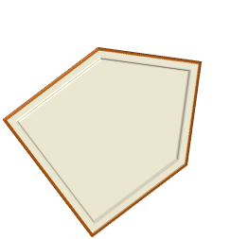

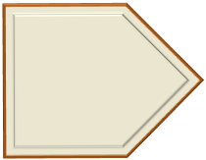


Guide to Product Development for the ecosystem
Create a Design Plan for your program or learning object. To consult with the Design or GCcampus Team contact Learn/Apprendre, to consult with the Video, Desktop Publishing or Development teams contact Learning.Service.Request.
At this phase your workshops, online self-paced, videos etc are being developed by the various teams. Contact Design and Gccampus through Learn/Apprendre and Editing, Development, Video through Learning.Service.Request.
Ask to present at SCIC. Provide a high level overview of your program now that you are almost ready to implement your GCcampus presence and content objects. Explain how you met the CSPS standards of Official Languages, Accessibility and Copyright compliance.
This involves creating storyboards for your online self-paced, scripts for your videos, detailed activities for your online instructor led courses.
Present your Design Plan/Proposal at the School Content Integration Committee (SCIC). Refer to SCIC Decision Points in LCDP.
Ask the Design Team for assistance with your content analysis and planning of your learning solution. Contact them through Learn/Apprendre.
Send final page content and links to content objects (if ready) to Learn/Apprendre using the form provided.
Your program idea is an approved part of the core curriculum and you need to devise a learning solution. What do you do?
Plan your project and consult all stakeholders: Design Team, Development team, Studio 2136, GCcampus team, Comms, Evaluation, SMEs
i
FINISH
Ensure any Trackable content objects are created on the ILMS. Ensure Moodle content is ready.
Add Content Objects to eSchool
START
i
Analyse and Plan
Check in with GCcampus
Finalize
Content
Objects
i
i
Create Design Plan/Proposal
i
i
SCIC Gate 3
Present your Design Plan at SCIC
i
i
i
Plan project and consult stakeholders
Development of Content Objects
Design Content Objects

